Slide 1
Data Ethics
Ethical Framework
Algorithmic Bias/Fairness (COMPAS)

Slide 2

Ethical frameworks

Slide 3
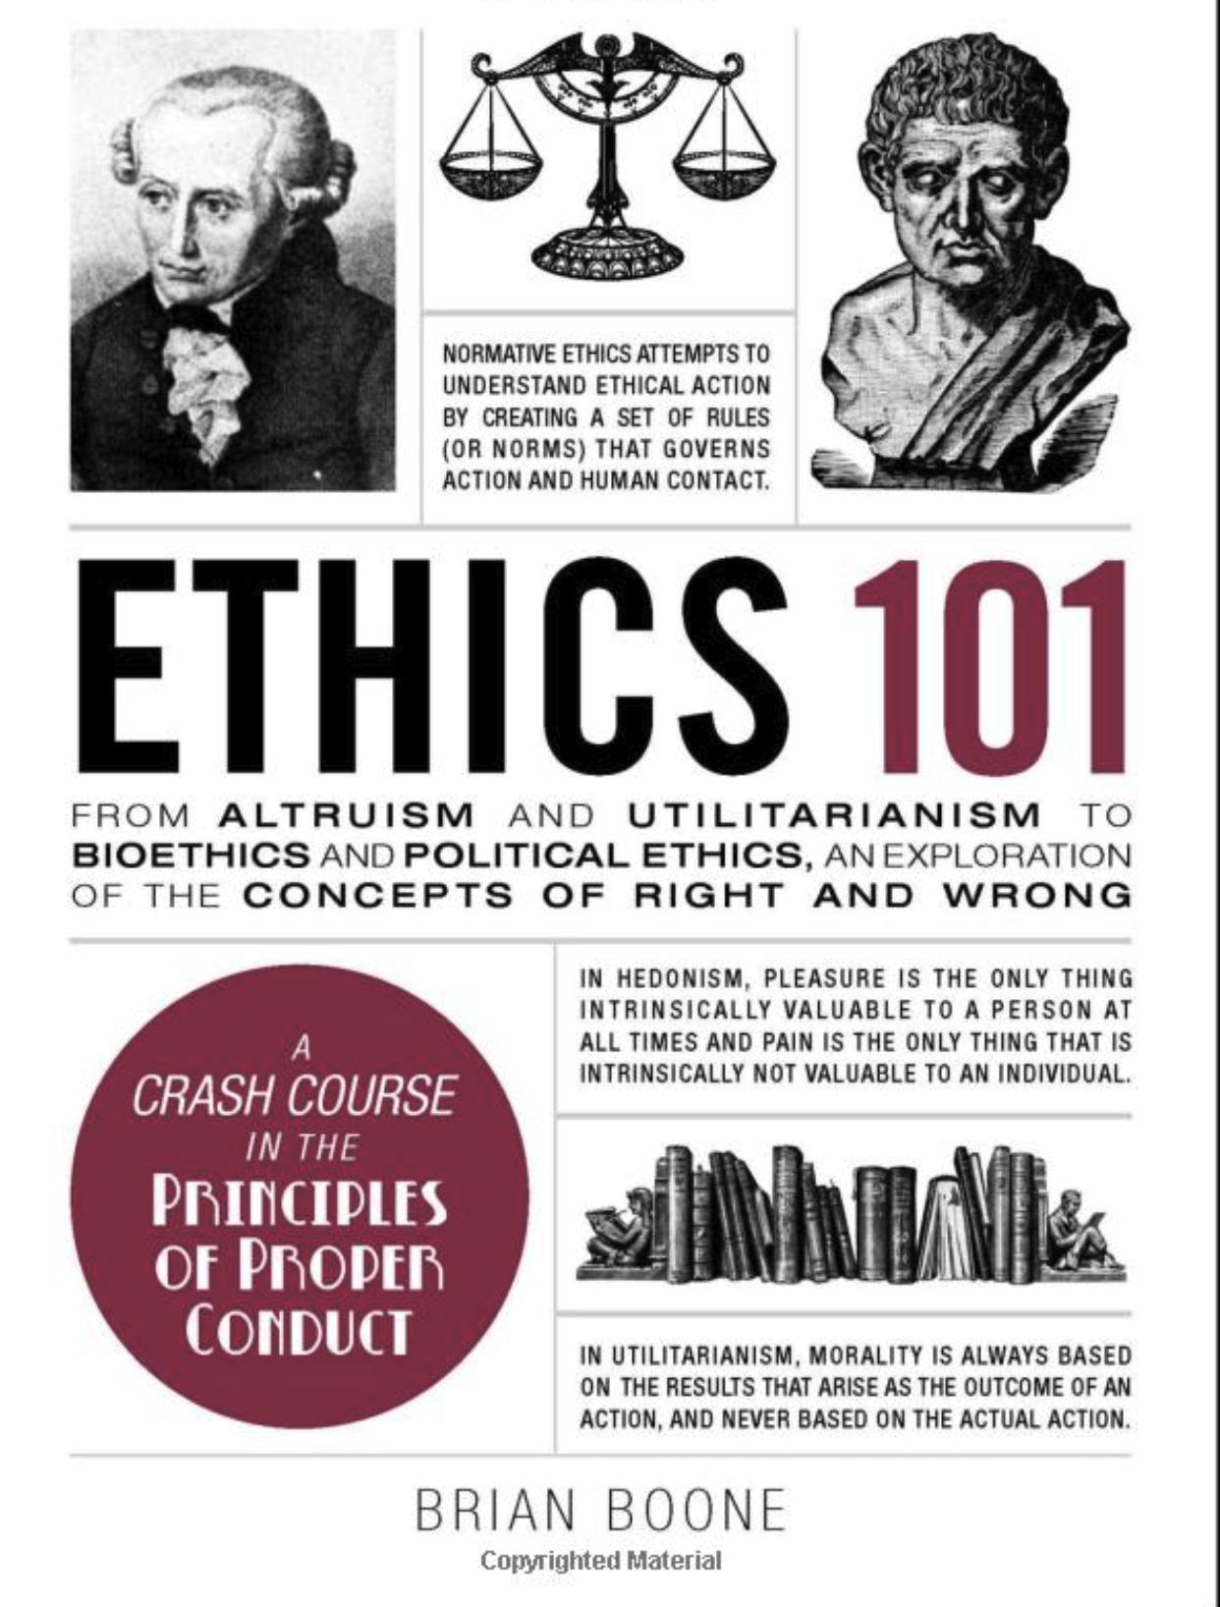
Highly Recommended Book
Informative and Well Written
Not gazillions of pages long
Only 10 bucks

Slide 4
Some Easy-reading Books
A Human's Guide to Machine Intelligence: How Algorithms Are Shaping Our Lives and How We Can Stay in Control by Kartik Hosanagar
Weapons of Math Destruction: How Big Data Increases Inequality and Threatens Democracy by Cathy O'Neil (one of the most famous book in this topic)
The Ethical Algorithm: The Science of Socially Aware Algorithm Design by Michael Kearns, Aaron Roth (high quality book written by prominent CS and social science scholar)
You Look Like a Thing and I Love You: How Artificial Intelligence Works and Why It's Making the World a Weirder Place by Janelle Shane (Quirky and Fun)
Algorithms of Oppression: How Search Engines Reinforce Racism by Safiya Umoja Noble
Artificial Intelligence: A Guide for Thinking Humans by Melanie Mitchell

Slide 5
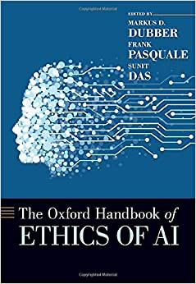
A good one to have
Syllabus has more recommendations for you too see including some nice websites.

Slide 6
Three ethical frameworks
This class: Focus on these two frameworks
Consequentialism
An act is good if it results in a good outcome, on balance
Deontology
An act is good if it is consistent with moral duties or rules (e.g. do not lie)
Virtue Ethics
An act is good if it is motivated by virtuous (moral excellence & quality) intention and wisely executed

Slide 7
Consequentialism

Slide 8
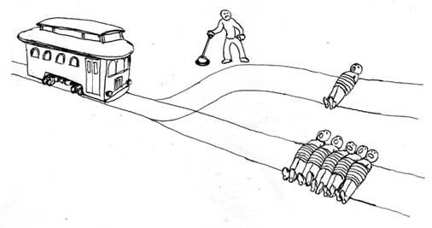

Trolley Problem: poll
Will you switch the track from five people to one person?

Slide 9
Consequentialism
A variety of related ethical perspectives that judge the moral rightness of an act by a moral accounting of its consequences

Slide 10
The ends justify the means
Example: Should I use credit scores in my hiring decisions?
Consequentialist questions:
does it help people more than it hurts people?
Are the aggregate consequences of using it better than the aggregate consequences of not using it?
Are the aggregate consequences of using it better than the aggregate consequences of using some other proxy in my hiring decisions

Slide 11
How do we measure consequences?
Hedonism
Pleasure is the highest good
Preference utilitarianism
Fulfillment of preferences and
interest of the subjects
Pluralism – not one single objectives. Obligations from all ethical theories (may conflict) must be considered then judge how to proceed
Add truth, beauty, fairness, justice, friendship, etc…
Utilitarianism
Desired outcome: the max amount of good for the max number of people.
Objections: fails for those who take pleasure in causing harm, those who have irrational preferences. How to compare different people’s pleasure or preferences?

Slide 12
Types of consequences
Actual Consequentialism
Actual consequences
Relaxations of Actual Consequentialism:
Foreseen consequences
Things you actually knew would happen
Foreseeable consequences
Things you could have known would happen (if you were paying attention etc)
Intended consequences
Things you intended to happen

Slide 13
Sometimes different types of consequences are in conflict
Which is better?
Giving one person $100 and nine people $0
Giving 10 people $8 each
Notes:
Discussion exercise. Ask for reasons why one of these outcomes is better
Things that might come up:
Simple consequentialism – Option 1 is greatest total gift, thus better
Simple consequentialism – diminishing marginal utility means option 2 results in greatest benefit
Pluralism – option 2 is also more just or fair, thus better
Consequentialism - Who needs it most?

Slide 14
Challenges to consequentialism
Some consequences are hard or impossible to compare
How do we weigh the benefit of increased total happiness against the cost of decreased fairness?
If we can’t compute the consequences, then we cannot determine the best course of action
Requires some way of integrating or aggregating different types of costs and benefits
Some consequences are unintended or impossible to foresee
Therefore, cannot calculate costs and benefits in advance
Only useful as an ex post facto measure of the moral rightness of an action
One can only use accumulated experience (practical wisdom) to infer expected outcomes

Slide 15
Challenges to consequentialism: example
Fred meets a homeless man who is cold, and hungry. Fred wants to help. He buys the man dinner and rents them a hotel room for the night. During the night there is an explosion at the hotel due to a natural gas leak, and the man is killed.
Did Fred do something morally bad?
According to actual consequentialism: yes
Does this reveal a flaw in actual consequentialism?
Are other ethical perspectives better?
Notes:
Actual consequentialism: The homeless man died as a consequence of Fred’s actions, therefore, Fred’s actions were morally wrong
… leads to virtue ethics – the intention to be charitable was there – this guided action. Consequences were out of Fred’s control.

Slide 16
Transplant problem: poll
You are a transplant surgeon. In your hospital, there are 5 people who each need a different organ to live.
There is a healthy person in the waiting room.
Should you give the healthy person’s organs to the 5 sick patients?
If you give the healthy person’s organs, he will die, but the five sick people will live.
If you don’t, the healthy person will live, but the five sick people will die
Notes:
Leads to deontology: doctor has a duty to do no harm

Slide 17
Deontology
(deont: what is necessary + ology: study of)

Slide 18
Deontology
The right is more important than the good
Some acts are not right (lying, killing, stealing etc) and should not be done (they are morally forbidden), even if they result in something good
Acts that are right can be done (they are morally permitted or required)
even if they do not result in good consequences

Slide 19
Deontology
Deontology rule of thumb: only do acts that would still be acceptable if everyone always did them
Don’t lie: if everyone lied, there would be no way to communicate, no trust, no cooperation etc
Don’t kill: if everyone killed, we’d all be dead

Slide 20
Patient-centered deontology OR Agent-centered deontology
Some duties may be specific to a certain person (“agent-relative”)
Parents have a duty to care for their own child
Parents are permitted to rescue their own child, rather than other children in a situation of danger
even if they could save more lives by attending to other children
in contrast: utilitarian consequentialist theories would generally say you should save the most lives
Agent-relative reasons to act are still objective, not subjective or psychologically-rooted
Notes:
Agent-centered deontology is attractive in that it is descriptive of behavior, even if logically it’s not always clearly compelling as a prescriptive framework

Slide 21
The idea of “agency” is important in some varieties of deontology:
The morality of an action depends on whether the act is
Actively initiated
Merely allowed to happen, or influencing something already in process
Trolley v. Transplant:
Trolley problem:
Trolley will cause death, either way (single person is potentially in path of trolley)
Agent merely influences something already in process (permitted)
Healthy person not in harm’s way.
5 transplant patients are threatened by organ failure, which cannot be redirected, like the trolley
Agent actively initiates a new harm (forbidden)
Transplant Case:
Patient-centered deontology OR Agent-centered deontology

Slide 22
Centered around rights of the “target” of an act
Aka patient
Not the duties of an agent
Like agent-centered deontology, still based on a set of rules, rather than outcomes
E.g. right against being used as a means to another person’s ends
Leads to different moral reasoning
Patient-centered deontology OR Agent-centered deontology
Notes:
Examples from stanford dictionary of philosophy of where they differ:
Someone who is sick – let them sacrifice themselves. Allowance. But patient centered still says no
When all will die in a lifeboat unless one is killed and eaten; when Siamese twins are conjoined such that both will die unless the organs of one are given to the other via an operation that kills the first; when all of a group of soldiers will die unless the body of one is used to hold down the enemy barbed wire, allowing the rest to save themselves; when a group of villagers will all be shot by a blood-thirsty tyrant unless they select one of their numbers to slake the tyrants lust for death

Slide 23
Bomb threat
A nuclear bomb has been placed in a hidden spot. It will kill millions of people unless it is disarmed. There are only minutes left before detonation.
The terrorist who placed the bomb implanted an electronic device that will disarm the bomb in an innocent but sick person’s body.
The only way to save millions of people is to cut out the device, accelerating the sick person’s death.
What would a consequentialist say?
Agent-centered deontologist?
Patient-centered deontologist?

Slide 24
Virtue Ethics

Slide 25
Virtue Ethics
What distinguishes virtue ethics from consequentialism or deontology is the centrality of virtue within the theory (Watson 1990; Kawall 2009). Whereas consequentialists will define virtues as traits that yield good consequences and deontologists will define them as traits possessed by those who reliably fulfil their duties, virtue ethicists will resist the attempt to define virtues in terms of some other concept that is taken to be more fundamental.

Slide 26
Components of virtue ethics
Virtue Ethics
Arete: virtue, excellence
Eudaimonia:
Happiness, flourishing, fulfillment
Phronesis:
Practical wisdom
e.g. generosity, courage, honesty
The kind of happiness that comes from being virtuous
How to use virtues to do the right thing

Slide 27
Virtue ethics
A good person is
Virtuous
Has learned how to achieve desired outcomes
Is fulfilled from a life of virtue
e.g.: an honest person
Tells the truth
In the right time and place, so people listen
Sincerely wants to be honest/Is fulfilled by honesty

Slide 28
Varieties of virtue ethics
Eudamonism
good acts are those that produce eudaimonia
Agent-based
Good acts are those that are performed with virtuous intention

Slide 29
Challenges to virtue ethics
Not very helpful to people who aren’t virtuous or don’t have practical wisdom
Is it enough to tell somebody to “be generous?”
More descriptive than prescriptive
Conflicts between virtues are resolved by practical wisdom
Should I lie to preserve my friend’s feelings (kindness) or should I tell the truth (honesty)
Practical wisdom (how to achieve a good outcome) is gained through experience, not helpful to people who lack it
More focused on what kind of person to be than what to do
Not helpful in judging specific actions
People might mean well but do harm

Slide 30
Combining Ethical Perspectives

Slide 31
In this class
Moral philosophers attempt to refine or argue for/against certain ethical perspectives
There are *many* variants of the three perspectives, as well as perspectives we won’t cover
Our purposes are simpler:
To gain habits of thought that allow us to analyze ethics of data/ AI algorithms from different perspectives

Slide 32
We ask questions about uses of data/AI
Does the use of data/ai result in good consequences, morally speaking?
Are moral harms offset by moral benefits?
Is moral benefit maximized by this use of data?
Is the use of data/ai consistent with moral duties?
Does it cause direct harm to another person?
Does it use one person as a means for another person’s ends?
Is the use of data/ai motivated by virtue?
Is the intention behind the use of data to help people? To create something of value?
Is it motivated by the desire to capture value?

Slide 33
Values

Slide 34
Values: moral objectives
Consequentialism, deontology, and virtue ethics are general perspectives on how to approach the question of what is good
They cannot serve as complete definitions of what is good
All theories rely on something hard to define
How do we measure the value of consequences?
Which rules are good rules?
What are relevant virtues?

Slide 35
Exercise: identify your values (15 min)
What are your values?
Which values guide your own actions?
How can you tell if you are doing a morally good or morally permissible thing?
How do you define “the good?”
Can be in terms of consequences or moral duties/rules
Phase 1: individual reflection and writing
What are your values?
Can you rank your values? Are some more important?
Phase 2: anonymous aggregation

Slide 36
Values: moral objectives
In practice, we will be defining our own moral objectives – those things by which we will judge the ethics of an action
Individual level
Individual welfare/utility
Fairness/justice
Privacy
Respect for persons, autonomy
Collective level
Aggregate welfare
Social integration/feeling of community

Slide 37
Which of the following is an example of a consequentialism argument in favor of a use of data/AI?
A: Although we collect private information, the benefit our algorithm provides outweighs the cost
B: We never deceive users in our experiments on user behavior; we always obtain informed consent
C: Our algorithm is designed to make the world a better place by bringing like-minded people together
All of the above

Slide 38
Ways of evaluating ethics of a use of data
Frameworks/perspectives
Consequentialism
Deontology
Virtue ethics
Values/objectives/virtues
Fairness
Privacy
Honesty
Etc…
Ethical judgments involve both types of considerations

Slide 39
Self Driving Car Ethics

Slide 40
Self Driving Car Ethics!
https://www.youtube.com/watch?v=tb-WdVA4_bo&t=5s
Ted Talk MIT Moral Machines

Slide 41
Try it yourself!
https://www.moralmachine.net/

Slide 42
Let’s Discuss
What were your values?
How did you compare against the public
Were you a consequentialist or deontologist?

Slide 43
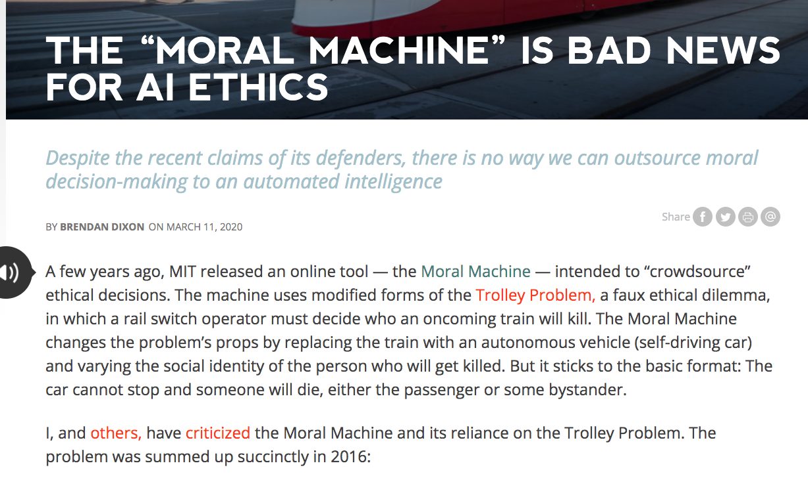
https://mindmatters.ai/2020/03/the-moral-machine-is-bad-news-for-ai-ethics/

Slide 44
Fairness

Slide 45
Fairness and “classes” of people
Historically and currently, certain groups of people have been discriminated against (treated unfairly) by others in society—especially by those in power. The unfair treatment comes from individuals and from the way our social systems are created.
Unfair treatment occurs because of (for example):
Race
Color
Sex
National or ethnic origin
Sexual orientation
Gender identity
Religion
Disability or bodily attributes

Slide 46
Fairness and “classes” of people
The law in the U.S. and elsewhere officially prohibits certain kinds of unfair treatment, but of course it still happened and happens now.
“protected classes” means groups that are protected under U.S. law
Which groups are protected under law has evolved through time and continues to evolve
Which groups face unfair treatment varies by culture and evolves over time as well

Slide 47
Focus on Algorithmic Fairness
Context:
Algorithms in the judicial system.
Are they fair to people of different races?

Slide 48
“Recidivism”
A person is arrested because they are suspected of a crime
In a pre-trial hearing, a judge (or algorithm, or both) will decide if the person who was arrested must wait for their trial in jail, or if they can post bail (pay money to the government) and wait for their trial at home.
The decision is partly based on whether the court thinks the suspect (person who was arrested) is likely to be a continued danger to society (i.e. be arrested again) while waiting for trial.
“Recidivism” = committing another crime
The trial can be months after the arrest, so the consequences of the decision are very large.

Slide 49

COMPAS
Correctional Offender Management Profiling for Alternative Sanctions (COMPAS)

Slide 50
COMPAS
Correctional Offender Management Profiling for Alternative Sanctions (COMPAS) is a case management and decision support tool developed and owned by Northpointe (now Equivant) used by U.S. courts to assess the likelihood of a defendant becoming a recidivist

Slide 51
What do they “predict”?
Pretrial Release Risk scale: Pretrial risk is a measure of the potential for an individual to fail to appear and/or to commit new felonies while on release.
General Recidivism scale: The General Recidivism scale is designed to predict new offenses upon release.
Violent Recidivism scale: The Violent Recidivism score is meant to predict violent offenses following release.

Slide 52
Dataset
compas-scores-two-years.csv

Slide 53
Does the risk score predict the outcome?
A lawyer is asking you if decile_score (the outcome variable of a predictive model) can be used to decide who waits for trial in jail vs. at home.
Does decile_score predict is_recid?

Slide 54
How should we define “high risk”
What threshold should we apply to the decile_score to label people as “high risk” to judges?
How did you come to that decision?
Qualitative?
Quantitative?

Slide 55
Is the algorithm fair to people of different races?
Compare how well decile_score predicts is_recid for
Caucasian
African-American
Is the algorithm biased against either one of the groups?

Slide 56
Confusion matrix
 | Reality: TRUE | Reality: FALSE
Prediction: TRUE | TRUE POSITIVE | FALSE POSITIVE
Prediction: FALSE | FALSE NEGATIVE | TRUE NEGATIVE

Slide 57
Confusion matrix
 | is re-arrested | Is not re-arrested
High risk | TRUE POSITIVE | FALSE POSITIVE
Low risk | FALSE NEGATIVE | TRUE NEGATIVE

Slide 58
Overall
Is this a fair algorithm w.r.t. people of different races?
How can you tell?

Slide 59
In-Class Assignment
Work as a group (final project & in-class exercise group)
Create at least one definition of fairness (consider confusion matrix, protected variables)
Write it down and try to be specific and concrete! Equations or precise language
Evaluate the Compas data according to your definition of fairness.
Provide evidence in the form of plots and/or tables
The Data & Descriptions are in Blackboard
Hint: Think about it in terms of Y’, Y, confusion matrix, some objective function, and a protected variable

